Slide 1
Automated Meta-Programming to Support High-Performance OCaml Codes
B. Comp Dissertation
Arnold Christopher Koroa
Department of Computer Science, School of Computing
National University of Singapore
2014/2015

Slide 2
Automated Meta-Programming to Support High-Performance OCaml Codes
???
B. Comp Dissertation
Not Manual
/səˈpɔːt/ verb bear all or part of the weight of
Fast!!
A Programming Language
Arnold Christopher Koroa
Department of Computer Science, School of Computing
National University of Singapore
2014/2015
My Name
My School

Slide 3
Meta-Programming
Programs that manipulate other programs
“Code fragment objects” as data
Create new code
Modify existing code

Slide 4
Meta-Programming, how is it useful?
“Free” compiler from an interpreter
Partial evaluation of an Domain Specific Language (DSL) interpreter to a DSL program
Produces code in the interpreter’s implementation language
Can then reuse the interpreter’s implementation language’s compiler

Slide 5
Meta-Programming, how is it useful?
“Free” compiler from an interpreter
(* if n = 0 then 1 else x * 200 *)
Ifz (Var “n", Int 1, Mul (Var "x", Int 200))
let rec eval e env =
match e with
Int i -> i
| Var s -> env s
| App (s,e2) -> (fenv s) (eval e2 env)
| Add (e1,e2) -> (eval e1 env fenv) + (eval e2 env)
| Sub (e1,e2) -> (eval e1 env) – (eval e2 env)
| Mul (e1,e2) -> (eval e1 env) * (eval e2 env)
| Div (e1,e2) -> (eval e1 env) / (eval e2 env)
| Ifz (e1,e2,e3) -> if (eval e1 env fenv) = 0
then (eval e2 env fenv)
else (eval e3 env fenv)

Slide 6
Meta-Programming, how is it useful?
“Free” compiler from an interpreter
let rec eval e env fenv =
match e with
Int i -> .<i>.
| Var s -> env s
| App (s,e2) -> .<.~(fenv s) .~(eval e2 env fenv)>.
| Add (e1,e2) -> .<.~(eval e1 env fenv) + .~(eval e2 env fenv)>.
| Sub (e1,e2) -> .<.~(eval e1 env fenv) - .~(eval e2 env fenv)>.
| Mul (e1,e2) -> .<.~(eval e1 env fenv) * .~(eval e2 env fenv)>.
| Div (e1,e2) -> .<.~(eval e1 env fenv) / .~(eval e2 env fenv)>.
| Ifz (e1,e2,e3) -> .<if .~(eval e1 env fenv) = 0
then .~(eval e2 env fenv)
else .~(eval e3 env fenv)>.
=> .<if n = 0 then 1 else x * 200>.

Slide 7
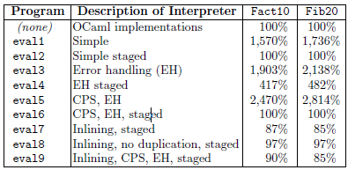
Meta-Programming, how is it useful?
“Free” compiler from an interpreter
Results from Taha (2004)

Slide 8
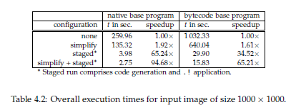
Meta-Programming, how is it useful?
“Free” compiler from an interpreter
Results from Hermann and Langhammer (2006)

Slide 9
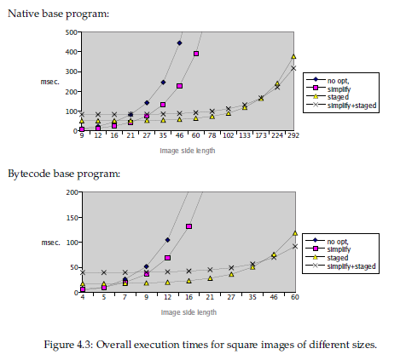
Meta-Programming, how is it useful?
“Free” compiler from an interpreter
Results from Hermann and Langhammer (2006)

Slide 10
Meta-Programming, how is it useful?
Efficient genericity and high level code
Adaptable code that optimizes to the problem being solved
input size
input/output type
Automatic optimization to platform
Detection and utilization of underlying hardware
Unrolling according to cache size
SSE
Distributed/Parallel Architecture

Slide 11
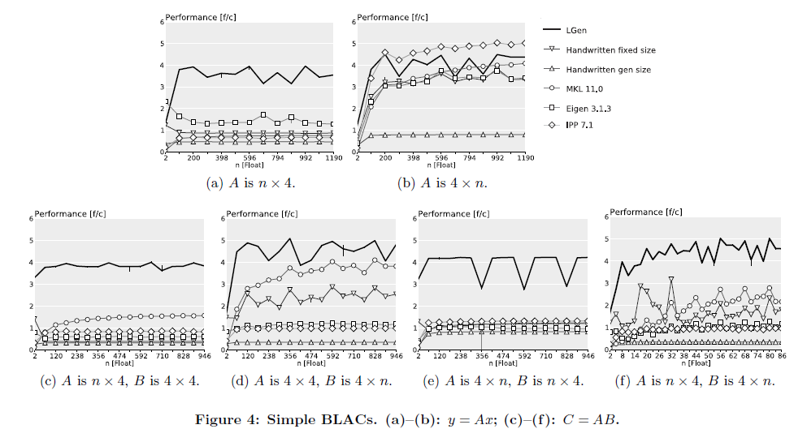
Meta-Programming, how is it useful?
Efficient genericity and high level code
Results from Spampinato and Puschel (2014)

Slide 12
Meta-Programming, how is it useful?
Efficient genericity and high level code
Results from Spampinato and Puschel (2014)

Slide 13
Meta-Programming, how to do it?
MetaOCaml
Multi-staged programming language
Allows the creation of delayed computations in the form of code
The delayed computations can produce further delayed computations
Based on OCaml

Slide 14
Meta-Programming, how to do it?
MetaOCaml
Bracket .< … >.
Delay the computation inside it
let plus2 x = .<x + 2>.;;
# plus2 3;;
: int code = .<3 + 2>.
Escape .~
Runs code pointed by it to produce code to be spliced
# .<.~(plus2 3) * .~(plus2 4)>.;;
: int code = .<(3 + 2) * (4 + 2)>.
Run !.
Executes a delayed computation
# !. .<.~(plus2 3) * .~(plus2 4)>.;;
- : int = 30

Slide 15
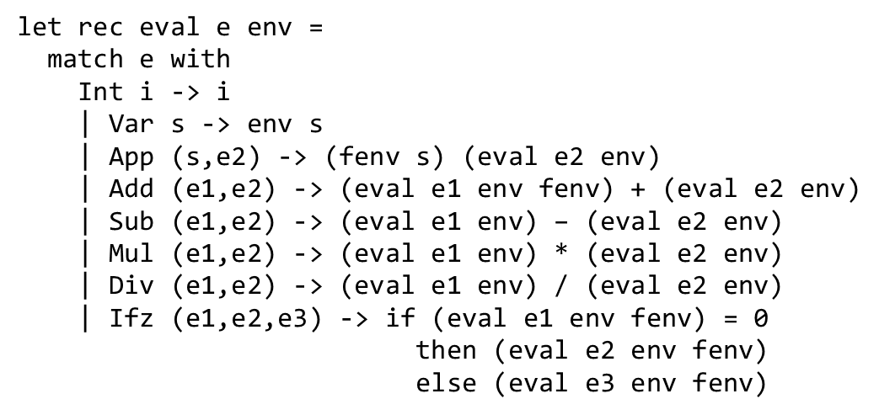
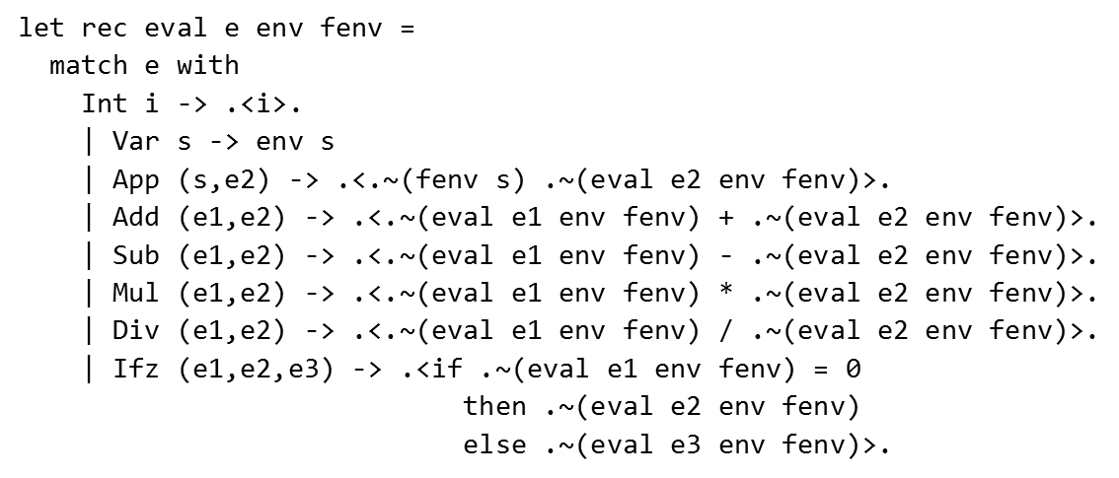
Meta-Programming, how to do it?
MetaOCaml
?

Slide 16
Project Objective
To automate the staging process, enabling users to reap the benefits of multi-staged meta-programming without having to deal with the complexities of manually staging source programs

Slide 17
Overview
Automated Staging of OCaml Codes
Translation Rules
Source Code Annotation
Source Code Preprocessing
Results
Conclusions

Slide 18
Overview
Automated Staging of OCaml Codes
Translation Rules
Source Code Annotation
Source Code Preprocessing
Results
Conclusions

Slide 19
Automated Staging of OCaml Codes
Annotate OCaml Code
What function to stage
What static information is available
Preprocess the annotated OCaml code
Extract information in annotations
Analyze and transform
Produce staged MetaOCaml code

Slide 20
Overview
Automated Staging of OCaml Codes
Translation Rules
Source Code Annotation
Source Code Preprocessing
Results
Conclusions

Slide 21
Translation Rules
Simple functions with no control flows or recursions
let plus x y = x + y
If y is always 2
=> let plus x = x + 2
How to stage?
=> let plus_staged y = .< let plus x = x + y in plus >.
Sample Run: # plus_staged 2;;
- : (int -> int) code = .< let plus x = x + 2 in plus >.

Slide 22
Translation Rules
let plus x y = x + y => let plus_staged y = .< let plus x = x + y in plus >.
<FunBody> => <FunBodyS>
______________________________________________________________________
let <FunName> <Args> = <FunBody>
=>_{toMeta}
let <FunName>_staged <StaticArgs> =
.< let <FunName> <DynArgs> = .~(<FunBodyS>) in <FunName> >.

Slide 23
Translation Rules
_____________________________________________
<FunBody> => .< <FunBody> >.

Slide 24
Translation Rules
Function with control flow
let f x y = if x > 0 then x + y else x - y
If y is static
=> let f_staged y = .< let f x = if x > 0 then x + y else x – y in f >.
If x is static?
=> let f_staged x = .< let f y = if x > 0 then x + y else x – y in f >.
# f_staged 1;;
- : (int -> int) code = .< let f y = if 1 > 0 then 0 + y else 0 – y in f >.

Slide 25
Translation Rules
Function with control flow
let f x y = if x > 0 then x + y else x - y
If x is static
=> let f_staged x =
let aux x y = if x > 0 then .< 0 + .~y >. else .< 0 – .~y >.
in .< let f y = .~(aux x .<y>.) in f >.
# f_staged 1;;
- : (int -> int) code = .< let f y = 1 + y in f >.

Slide 26
Translation Rules
Function with control flow
Nested control structures?
let f x y = if x = 0 then (if y = 0 then true else false) else false
If y is static
=> let f_staged y =
let aux x y = if y = 0 then .<true>. else .<false>. in
.< let f = if x = 0 then .~(aux x y) else false in f

Slide 27
Translation Rules
Function with control flow
Nested control structures?
let f x y = if x = 0 then (if y = 0 then true else false) else false
If both x and y are static
=> let f_staged x y =
let aux_2 x y = if y = 0 then .< true >. else .< false >. In
let aux_1 x y = if x = 0 then .~(aux_2 x y) else .< false >. In
.< let f = .~(aux_1 x y) in f >.

Slide 28
Translation Rules
___________________________________
<FunBody> => ([], .< <FunBody> >.)
<FunBody> => ([<Aux₁>, …, <Aux_{n}>], <FunBodyS>)
________________________________________________________________________
let <FunName> <Args> = <FunBody>
=>_{toMeta}
let <FunName>_staged <StaticArgs> =
let <AuxName₁> = <AuxBody₁>
and …
and <AuxName_{n}> = <AuxBody_{n}> in
.< let <FunName> <DynArgs> = .~(<FunBodyS>) in <FunName> >.

Slide 29
Translation Rules
For if-then-else structure with statically computable condition
isStatic(CondExp)
<ThenBody> => (ThenAuxList, <ThenBodyS>) <ElseBody> => (ElseAuxList, <ElseBodyS>)
________________________________________________________________________________________________
if <CondExp> then <ThenBody> else <ElseBody>
=>
( ThenAuxList @ ElseAuxList @
[if <CondExp> , .< .~(aux <Args[DynArg->.<DynArg>.]>) >.
then .< .~(<ThenBodyS[DynArg->.~DynArg]>) >.
else .< .~(<ElseBodyS[DynArg->.~DynArg]>) >.] )

Slide 30
Translation Rules
For if-then-else structure with non-statically computable condition
!isStatic(CondExp) <CondBody> => (CondAuxList, <CondBodyS>)
<ThenBody> => (ThenAuxList, <ThenBodyS>) <ElseBody> => (ElseAuxList, <ElseBodyS>)
________________________________________________________________________________________________
if <CondExp> then <ThenBody> else <ElseBody>
=>
( if .~(<CondExpS>)
CondAuxList @ ThenAuxList @ ElseAuxList , then .< .~(<ThenBodyS>) >.
else .< .~(<ElseBodyS>) >. )

Slide 31
Translation Rules
Function with recursion
let rec pow x n = if n = 0 then 1 else x * pow x (n - 1)
Change recursive call to the optimized function call
Omitted here for brevity

Slide 32
Translation Rules
Function that uses other staged function
let rec ff y m =
if y = 0 then 0 else (pow y m) + (ff (y - 1) m)
If m is static and pow is staged over its second argument
=> let ff_staged m =
let pow = !. .< .~(pow_staged m) >. in
.< let rec ff y =
if y = 0 then 0 else (pow y) + (ff (y - 1)) in ff >.

Slide 33
Translation Rules
Function that uses other staged function
=> let ff_staged m =
let pow = !. .< .~(pow_staged m) >. in
.< let rec ff y =
if y = 0 then 0 else (pow y) + (ff (y - 1)) in ff >.
# ffstaged 3;;
- : (int -> int) code =
.< let rec ff y =
if y = 0 then 0 else ((* CSP pow *) y) + (ff (y - 1))
in ff >.

Slide 34
Translation Rules
Function that uses other staged function
=> let ff_staged m =
let pow = !. .< .~(pow_staged m) >. in
.< let rec ff y =
if y = 0 then 0 else (pow y) + (ff (y - 1)) in ff >.
CSP = Cross-Stage Persistence
Values/functions from the code generator environment used in the produced code
Code generator environment needs to be available to the produced code
Assume ff_staged always called before the produced specialized code is used

Slide 35
Translation Rules
<FunBody> => ([<Aux₁>, …, <Aux_{n}>], <FunBodyS>)
________________________________________________________________________________
let <FunName> <Args> = <FunBody>
=>_{toMeta}
let <FunName>_staged <StaticArgs> =
let <StagedFun> = !. .< .~(<StagedFun>_staged <StaticArgs>) >. in
let <AuxName₁> = <AuxBody₁>
and …
and <AuxName_{n}> = <AuxBody_{n}> in
.< let <FunName> <DynArgs> = .~(<FunBodyS>) in <FunName> >.

Slide 36
Translation Rules
Now we know how to systematically translate OCaml code into a staged MetaOCaml code
Given the static information available to them
Staged code produces optimized function

Slide 37
Overview
Automated Staging of OCaml Codes
Translation Rules
Source Code Annotation
Source Code Preprocessing
Results
Conclusions

Slide 38
Source Code Annotation
How to indicate in the source program what is static?
OCaml Attributes
“decorations” attachable to OCaml AST
[@id payload] or [@@id payload] or [@@@id payload]
(1 + 2) [@doSomething]
let x = 2 [@@doSomething [data1;data2]]
Available since OCaml 4.02.1

Slide 39
Source Code Annotation
How to indicate in the source program what is static?
[@@static [statVar1; …; statVarn]
let rec pow x n =
if n = 0 then 1 else x * (pow x (n - 1))
[@@static [n]]

Slide 40
Source Code Annotation
How to indicate in the source program what is static?
[@@static [statVar1; …; statVarn]
let rec pow x n =
if n = 0 then 1 else x * (pow x (n - 1))
[@@static []] [@@static [x]] [@@static [n]] [@@static [x;n]]

Slide 41
Source Code Annotation
How to indicate in the source program if we use other (automatically) staged function?
[@static.use]
let rec ff x n =
if x = 0 then 0 else pow x n [@static.use] + ff (x - 1) n
[@@static [n]]
Necessary because sometimes we don’t want to use the static version

Slide 42
Overview
Automated Staging of OCaml Codes
Translation Rules
Source Code Annotation
Source Code Preprocessing
Results
Conclusions

Slide 43
Source Code Preprocessing
How to process the annotated code?
ppx Preprocessor
Mapper from OCaml AST to OCaml AST
Default mapper
Do deep identity mapping
Can be overridden at points where it takes in different OCaml AST nodes

Slide 44
Source Code Preprocessing
Hooking into the default mapper
let plus x y = x + y
structure
[ structure_item (foo.ml[1,0+0]..[1,0+20])
Pstr_value Nonrec
[ <def>
pattern (foo.ml[1,0+4]..[1,0+8])
Ppat_var "plus" (foo.ml[1,0+4]..[1,0+8])
expression (foo.ml[1,0+9]..[1,0+20]) ghost
Pexp_fun ""
None
pattern (foo.ml[1,0+9]..[1,0+10])
Ppat_var "x" (foo.ml[1,0+9]..[1,0+10])
expression (foo.ml[1,0+11]..[1,0+20]) ghost
Pexp_fun ""
None
pattern (foo.ml[1,0+11]..[1,0+12])
Ppat_var "y" (foo.ml[1,0+11]..[1,0+12])
expression (foo.ml[1,0+15]..[1,0+20])
Pexp_apply
expression (foo.ml[1,0+17]..[1,0+18])
Pexp_ident "+" (foo.ml[1,0+17]..[1,0+18])
[ <label> ""
expression (foo.ml[1,0+15]..[1,0+16])
Pexp_ident "x" (foo.ml[1,0+15]..[1,0+16])
<label> ""
expression (foo.ml[1,0+19]..[1,0+20])
Pexp_ident "y" (foo.ml[1,0+19]..[1,0+20])
]
]
]

Slide 45
Source Code Preprocessing
Hooking into the default mapper
let toMeta_mapper argv =
{ default_mapper with
structure = fun mapper structure_item_list -> … }

Slide 46
Source Code Preprocessing
Hooking into the default mapper
match structure_item with
{pstr_desc = Pstr_value (_, _)} ->
if hasToMetaAnnot structure_item
then (* do generation of staged code *)
else [default_mapper.structure_item mapper structure_item]
| _ -> [default_mapper.structure_item mapper structure_item]

Slide 47
Source Code Preprocessing
Extracting information and annotations
let f x = x + 1 [@@static [x]]
[{pstr_desc =
Pstr_value (Nonrecursive,
[{pvb_pat = {ppat_desc = Ppat_var {txt = "f"}};
pvb_expr =
{pexp_desc =
Pexp_fun ("", None, {ppat_desc = Ppat_var {txt = "x"}},
{pexp_desc =
Pexp_apply ({pexp_desc = Pexp_ident {txt = Lident "+"}},
[("", {pexp_desc = Pexp_ident {txt = Lident "x"}});
("", {pexp_desc = Pexp_constant (Const_int 1)})])})};
pvb_attributes =
[({txt = "static"},
PStr [{pstr_desc =
Pstr_eval
({pexp_desc =
Pexp_construct ({txt = Lident "::"},
Some {pexp_desc =
Pexp_tuple
[{pexp_desc = Pexp_ident {txt = Lident "x"}};
{pexp_desc = Pexp_construct ({txt = Lident "[]"}, None)}]})},
...)}])]}])}]

Slide 48
Source Code Preprocessing
Extracting information and annotations
OCaml Structure item (let-bound function defs): Pstr_value
Control structures: Pexp_ifthenelse, Pexp_match
Function application: Pexp_apply
Annotations: pvb_attributes, pexp_attributes

Slide 49
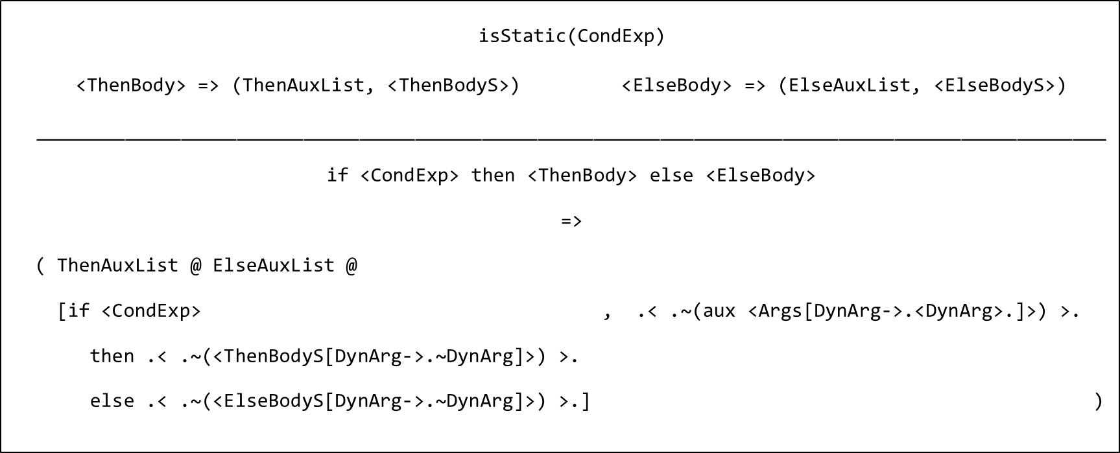
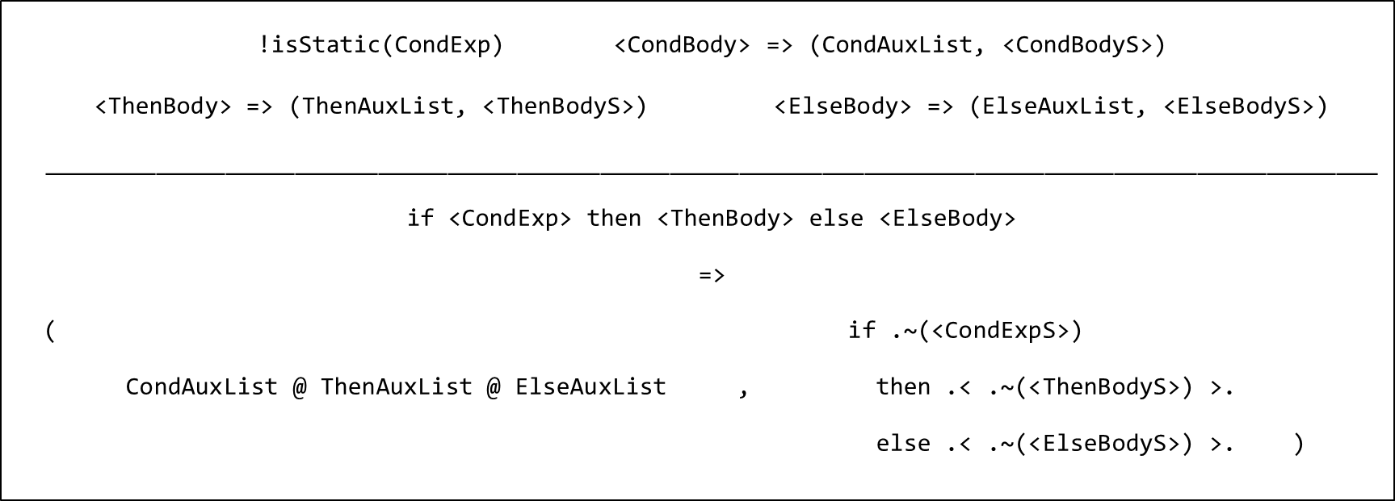
Source Code Preprocessing
Building the staged function

Slide 50
Source Code Preprocessing
Adding MetaOCaml Constructs
.< … >. -> [@metaocaml.bracket]
.~ -> [@metaocaml.escape]
!. -> Pexp_apply ({pexp_desc =
Pexp_ident {txt = Lident “!."}},
...

Slide 51
Overview
Automated Staging of OCaml Codes
Translation Rules
Source Code Annotation
Source Code Preprocessing
Results
Conclusions

Slide 52
Results
let rec pow x n = if n = 0 then 1 else x * (pow x (n - 1))
[@@static []] [@@static [x]] [@@static [n]] [@@static [x; n]]

Slide 53
Overview
Automated Staging of OCaml Codes
Translation Rules
Source Code Annotation
Source Code Preprocessing
Results
Conclusions

Slide 54
Conclusions
System that automates the staging process
Only by annotating the static information
No need to worry about staging constructs and levels
Get optimized code

Slide 55
Conclusions
However…
?

Slide 56
Conclusions
However…
Anonymous functions?
Curried functions?
Let-binding?

Slide 57
Conclusions
However…

Slide 58
Conclusions
However…
.< let ff m =
((* CSP pow *) m) + ((* CSP pow *) m) + 0
in ff >.

Slide 59
Conclusions
System that automates the staging process
Only by annotating the static information
No need to worry about staging constructs and levels
Get optimized code
However the success is still limited
There are various limitations which warrants further research

Slide 60
Thank You!
Ｖ ／￣￣￣＼ /| / ●＿＿●Ｖ | ｜ (･＿･) ノ / ヽノ ｜ (_ノ ﾉ ＼＿＿＿＿／ ｜ ｜ 个 个
Any Questions?

Slide 61
Appendices
Omitted slides for reference

Slide 62
Translation Rules
Function with recursion
let rec pow x n = if n = 0 then 1 else x * pow x (n - 1)
If x is static
=> let rec pow_staged x =
.< let pow n = if n = 0 then 1 else x * pow (n - 1) in pow >.
# pow_staged 5;;
- : (int -> int) code =
.< let pow n = if n = 0 then 1 else 5 * pow (n - 1) in pow >.

Slide 63
Translation Rules
Function with recursion
let rec pow x n = if n = 0 then 1 else x * pow x (n - 1)
If n is static
=> let rec pow_staged n =
let rec aux x n = if n = 0 then .< 1 >. else .< .~x * .~(aux x (n-1)) >.
in .< let pow x = .~(aux .<x>. n) in pow >.
# pow_staged 3;;
- : (int -> int) code = .< let pow x = (x * (x * (x * 1))) in pow >.

Slide 64
Translation Rules
For recursive function call in auxiliary function
isRecursiveCall() isInAux()
<Args> => (ArgsAuxList, <ArgsS>)
<ArgsS'> = <ArgsS[DynArgS->.<DynArgS>.]>
________________________________________________________
<FunName> <Args>
=>
( ArgsAuxList, .< <FirstAuxName> .~(<ArgsS'>) >. ))

Slide 65
Translation Rules
For recursive function call in main function body
isRecursiveCall() !isInAux()
<DynArgs> => (DynArgsAuxList, <DynArgsS>)
_______________________________________________
<FunName> <Args>
=>
( DynArgsAuxList, .< <FunName> .~(<DynArgsS>) >. )

Slide 66
Translation Rules
For all other function application
<Args> => (ArgsAuxList, <ArgsS>)
_______________________________________________
<FunName> <Args>
=>
( ArgsAuxList, .< <FunName> .~(<ArgsS>) >. )

Slide 67
Translation Rules
Function that uses other staged function
let rec ff y m = if y = 0 then 0 else (pow y m) + (ff (y - 1) m)
If y is static and pow staged over first argument
=> let ff_staged y =
let rec aux y m =
if y = 0 then .< 0 >. else .< (pow .~m) + .~(aux (y – 1) m) >.
in .< let pow = .~(pow_staged y) in
let ff m = .~(aux y .<m>.) in ff) >.

Slide 68
Translation Rules
For staged function application
isPrevStagedFun()
<DynArgs> => (DynArgsAuxList, <DynArgsS>)
__________________________________________________
<FunName> <Args>
=>
( DynArgsAuxList, .< <FunName> .~(<DynArgsS>) >. )

Slide 69
Results
let rec double xs = match xs with
| [] -> []
| x::xs -> (2 * x) :: (double xs)
[@@static []][@@static [xs]]

Slide 70
Results
let nestedBranch x y =
if x = 1 then (match y with | 0 -> "x0" | 1 -> "x1" | _ -> "xy“) else "_"
[@@static []][@@static [x]][@@static [y]][@@static [x; y]]

Slide 71
Results
let nestedBranch x y =
if x = 1 then (match y with | 0 -> "x0" | 1 -> "x1" | _ -> "xy“) else "_"
[@@static []][@@static [x]][@@static [y]][@@static [x; y]]

Slide 72
Results
let rec ff y m =
if y = 0 then 0 else ((pow y m)[@static.use ]) + (ff (y - 1) m)
[@@static []][@@static [y]][@@static [m]][@@static [y; m]]

Slide 73
Results
let rec ff y m =
if y = 0 then 0 else ((pow y m)[@static.use ]) + (ff (y - 1) m)
[@@static []][@@static [y]][@@static [m]][@@static [y; m]]

